Slide 1
File Systems
Group 2

Slide 2
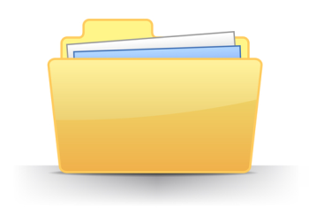
What is File System?
A file system is used to control how data is stored and retrieved.
Logic.
Speed.
Flexibility.
Security.
Size.

Slide 3
Layers of File System
Logical File Systems.
Virtual File Systems.
Physical File Systems.

Slide 4
Types of File System
File System
FAT
NTFS
REFS
EX FAT

Slide 5
File Allocation Table (FAT)
File Allocation Table (FAT) is a computer file system architecture and a family of industry-standard file systems utilizing it.
The FAT file system is a legacy file system which is simple and robust.
It offers good performance even in lightweight implementations, but cannot deliver the same performance, reliability and scalability as some modern file systems.

Slide 6
Types of FAT
FAT-8
FAT-12
FAT-16
FAT-32

Slide 7
FAT12: The oldest type of FAT uses a 12-bit binary number to hold the cluster number. A volume formatted using FAT12 can hold a maximum of 4,086 clusters, which is 2^12 minus a few values (to allow for reserved values to be used in the FAT). FAT12 is therefore most suitable for very small volumes, and is used on floppy disks and hard disk partitions smaller than about 16 MB (the latter being rare today.) 2,048 MB. VFAT is a variant of FAT16.

Slide 8
FAT16: The FAT used for most older systems, and for small partitions on modern systems, uses a 16-bit binary number to hold cluster numbers. When you see someone refer to a "FAT" volume generically, they are usually referring to FAT16, because it is the de facto standard for hard disks, even with FAT32 now more popular than FAT16. A volume using FAT16 can hold a maximum of 65,526 clusters, which is 2^16 less a few values (again for reserved values in the FAT). FAT16 is used for hard disk volumes ranging in size from 16 MB to

Slide 9
FAT32: The newest FAT type, FAT32 is supported by newer versions of Windows, including Windows 95's OEM SR2 release, as well as Windows 98, Windows ME and Windows 2000. FAT32 uses a 28-bit binary cluster number--not 32, because 4 of the 32 bits are "reserved". 28 bits is still enough to permit ridiculously huge volumes--FAT32 can theoretically handle volumes with over 268 million clusters, and will support (theoretically) drives up to 2 TB in size. However to do this the size of the FAT grows very large; see here for details on FAT32's limitations.

Slide 10
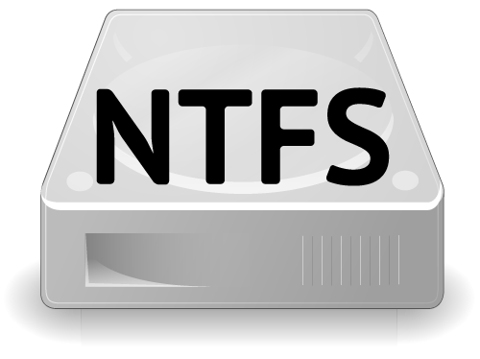
NTFS
NTFS ("New Technology File System")is a proprietary file system developed by Microsoft.
NTFS is the file system that the Windows NT operating system uses for storing and retrieving files on a hard disk.
Starting with Windows NT 3.1 in 1993, it is the default file system of Windows NT family.

Slide 11
Features
Theoretically, NTFS can support hard drives up to just under 16 EB.
NTFS supports disk usage quotas.
Encrypting File System (EFS).
Volume Shadow Copy Service (VSS).
Transactional NTFS.

Slide 12
Advantage of NTFS
There are some Windows 2000 operating system features that require NTFS.
Faster access speed. NTFS minimizes the number of disk accesses required to find a file.
Windows 2000 can format volumes up to 2 terabytes in size with NTFS.
The boot sector is backed up to a sector at the end of the volume.
NTFS supports a native encryption system called Encrypting File System (EFS), using public-key security to prevent unauthorized access to file contents.

Slide 13
Dis-advantage of NTFS
NTFS volumes are not accessible in MS-DOS, Windows 95, and Windows 98. Due to upgrades made to NTFS in Windows 2000, the advanced features of the Windows 2000 implementation of NTFS are not available in Windows NT 4.0 and earlier.
When very small volumes contain mostly small files, the overhead of managing NTFS may cause a slight performance drop in comparison to FAT.

Slide 14
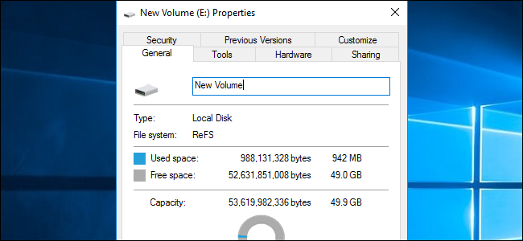
ReFS
Resilient File System (ReFS) is a type of disk file system that provides a disk storage management platform to Windows server operating systems. ReFS is also known as Protogon.

Slide 15
Key Features
Metadata integrity.
Integrity streams.
Copy on write.
Large volume, file and directory sizes.
Storage pooling and virtualization.
Data striping for performance (similar to RAID).
Disk scrubbing.
Resiliency to corruption.
Compatible with shared storage pools.

Slide 16
Maximum file name length | 255 Unicode characters
Maximum path name length | 32K Unicode characters
Maximum file size | 35 PB (petabytes)
Maximum volume size | 35 PB

Slide 17
The goals of Microsoft in building ReFS were:
Maintain a high level of compatibility with NTFS.
Make it able to verify and auto-correct data.
Optimize for extreme scale.
Make it able to stay always online, even in case of partial corruptions.
Provide a full end-to-end resiliency architecture when used in conjunction with the Storage Spaces feature.

Slide 18
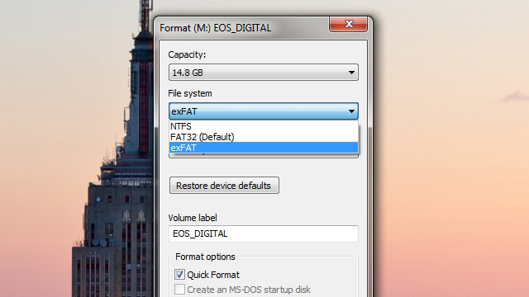
ExFAT
ExFAT (Extended File Allocation Table) is a file system designed and patented by Microsoft and released in all versions of Windows, starting with Windows Server 2008.

Slide 19
exFAT is considered the successor to the FAT16 and FAT32 file systems, and has become increasingly popular, gaining support from various third-party devices, including Western Digital hard drives.
It has a theoretical maximum disk size up to 64 ZB (Zettabytes) or 64 billion terabytes, versus a 32 GB maximum under a FAT32 partition

Slide 20
Using an external drive between Mac and Windows computers can be a hassle, since you constantly have to reformat it to fit which computer you're using it on. Instead of reformatting it all the time, just use the much more platform-independent exFAT and never format it again.
Windows' default NTFS is only readable on OS X, not writable, and Windows computers can't even read Mac-formatted HFS+ drives. FAT32 works for both OSes, but has a 4GB size limit per file, so it isn't ideal. You can always install drivers for those other OSes, but that doesn't help when you're sharing files with your friends' computers. Besides, it's kind of a hassle. The exFAT file system is a much simpler option

Slide 21
exFAT has been around for a while, but we've never really talked about it. Essentially, it's a file system that's both readable and writable on any modern Mac or Windows machine (sorry, XP users). All you need to do is format the drive on a Windows machine and you're good to go. Note that you can't format it on OS X, you have to format it on Windows for it to be compatible with both platforms. To do so, just:
1. Open up Windows Explorer and right-click on your drive in the sidebar. Choose "Format".
2. In the "File System" dropdown, choose exFAT instead of NTFS.
3. Click Start and close this window when finished.
From then on, that drive should work fantastically between Mac and Windows machines. It won't work with Linux unless you install Linux's exFAT drivers, but for most people, exFAT is just about perfect.

